Slide 1
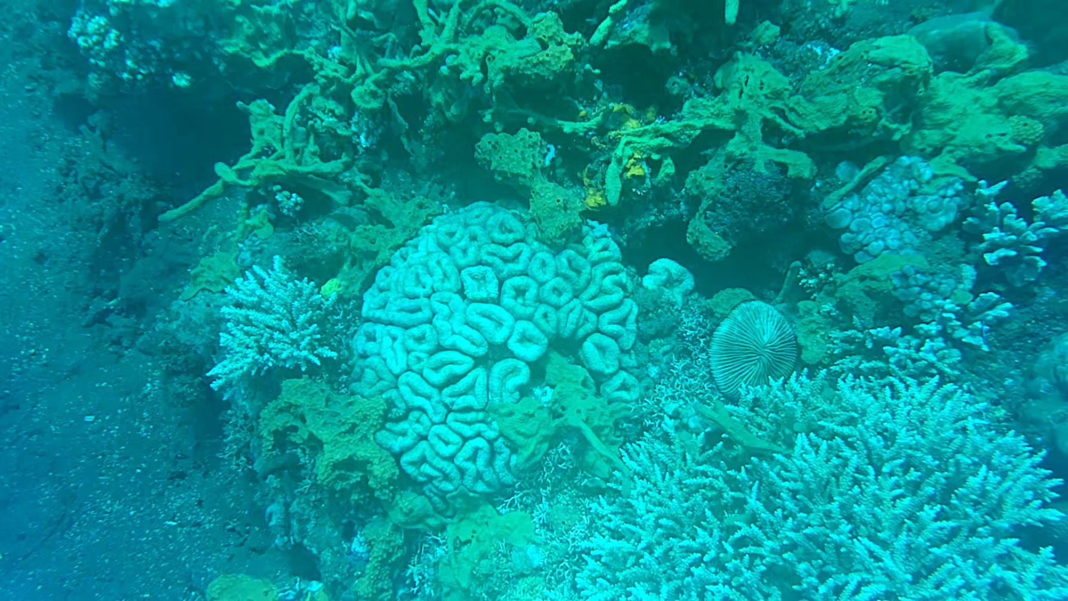
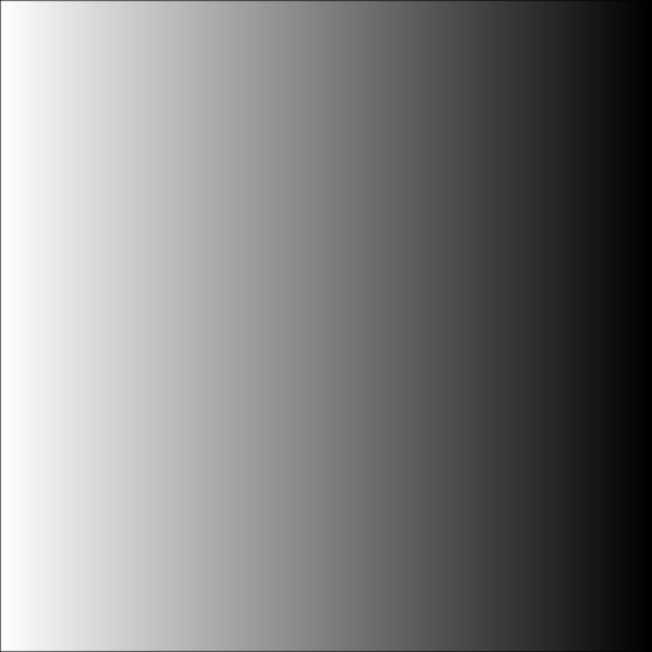

Coral Life Forms Detection
for Analysis of Climate Change
Impact on Coral Biodiversity
Oppenheimer & Alan Turing
9 February 2024

Slide 2

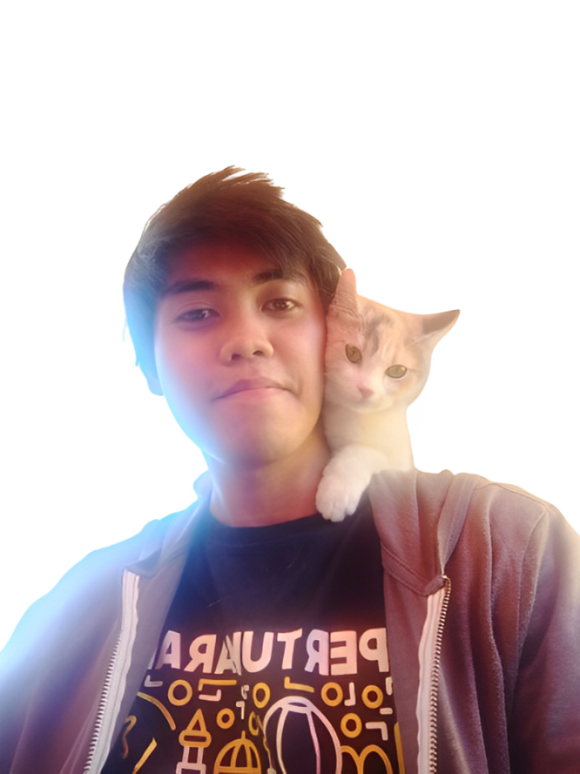
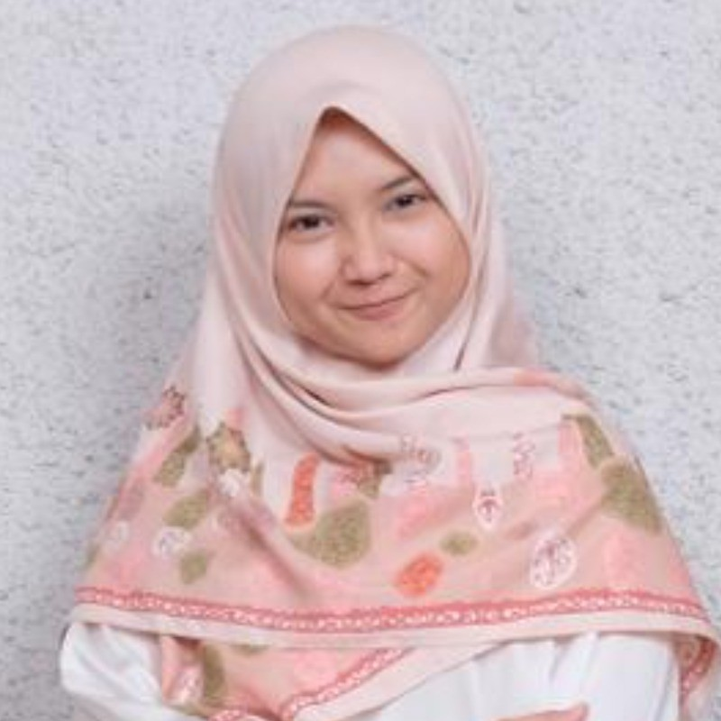
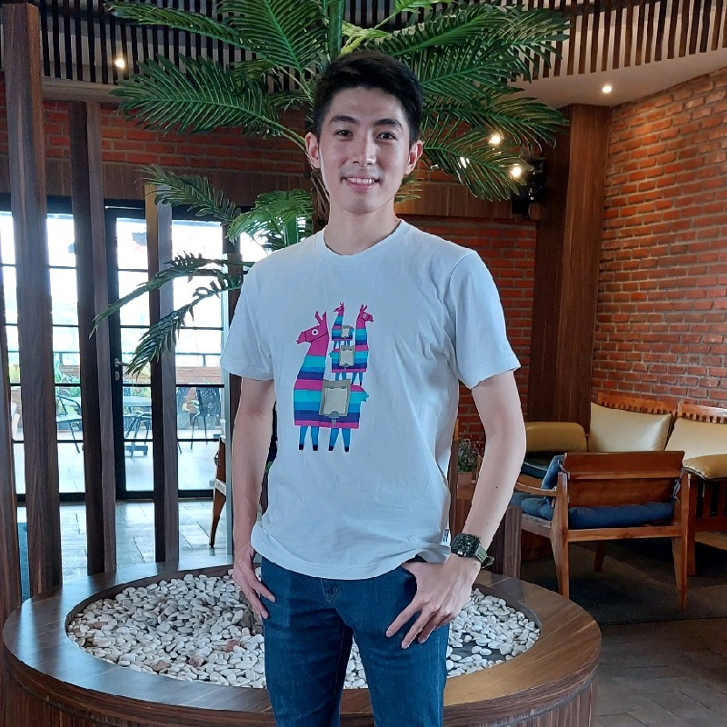
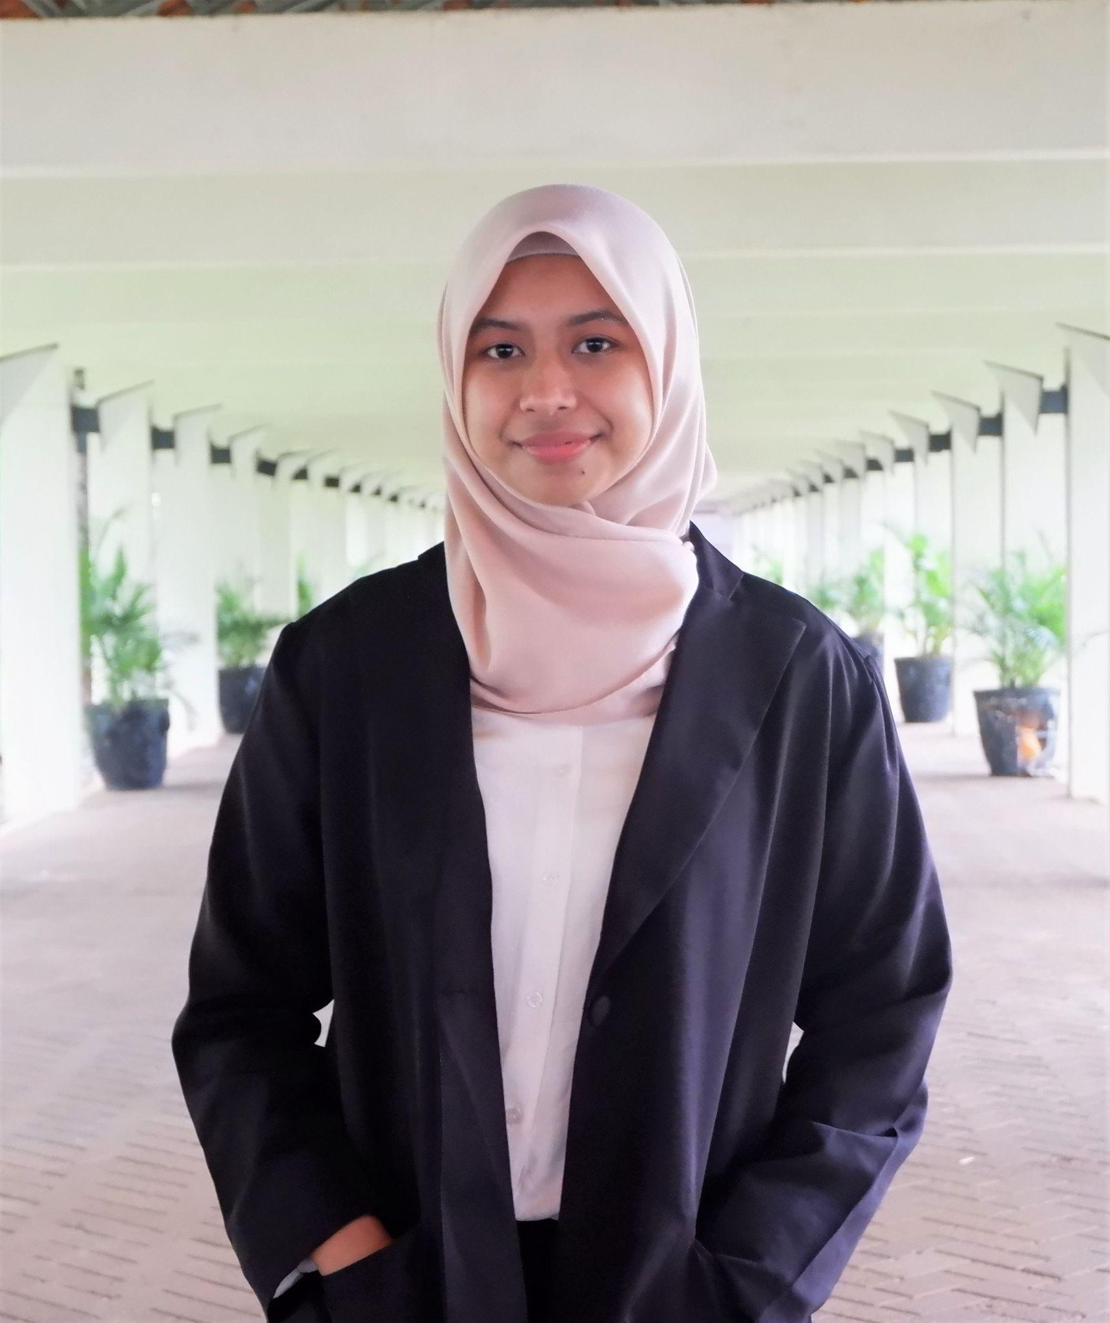
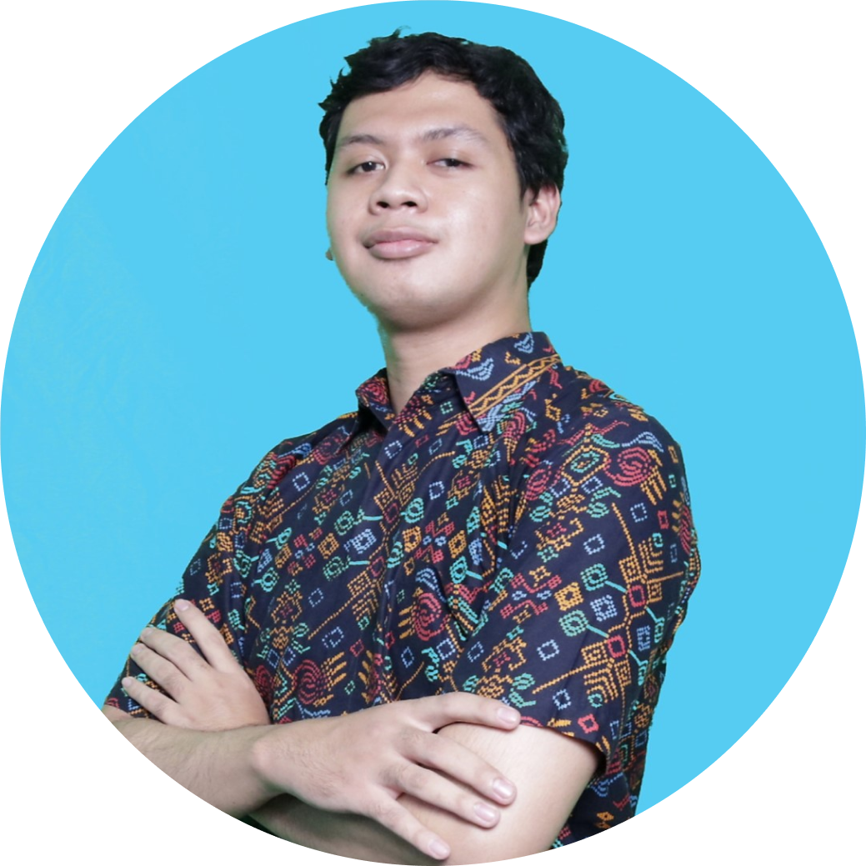

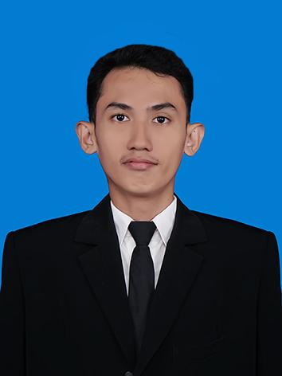
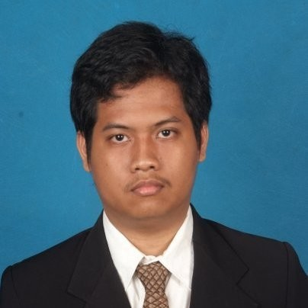
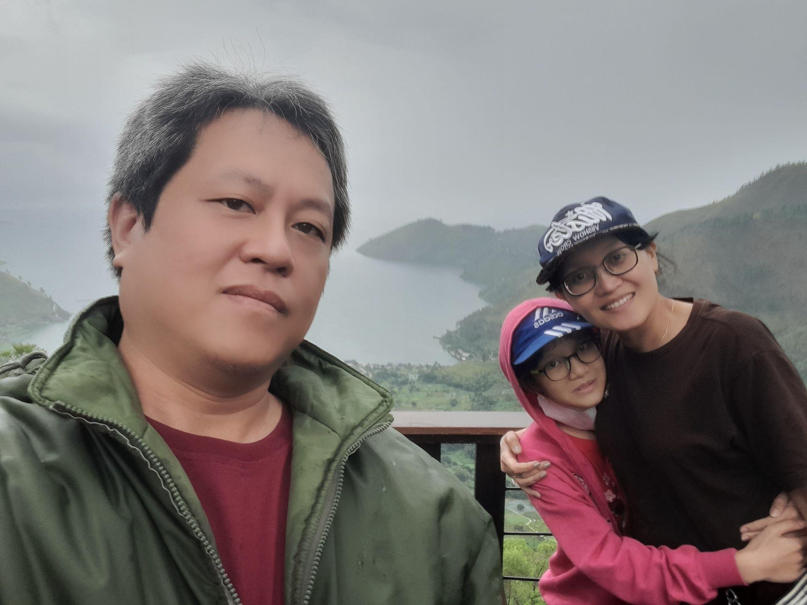
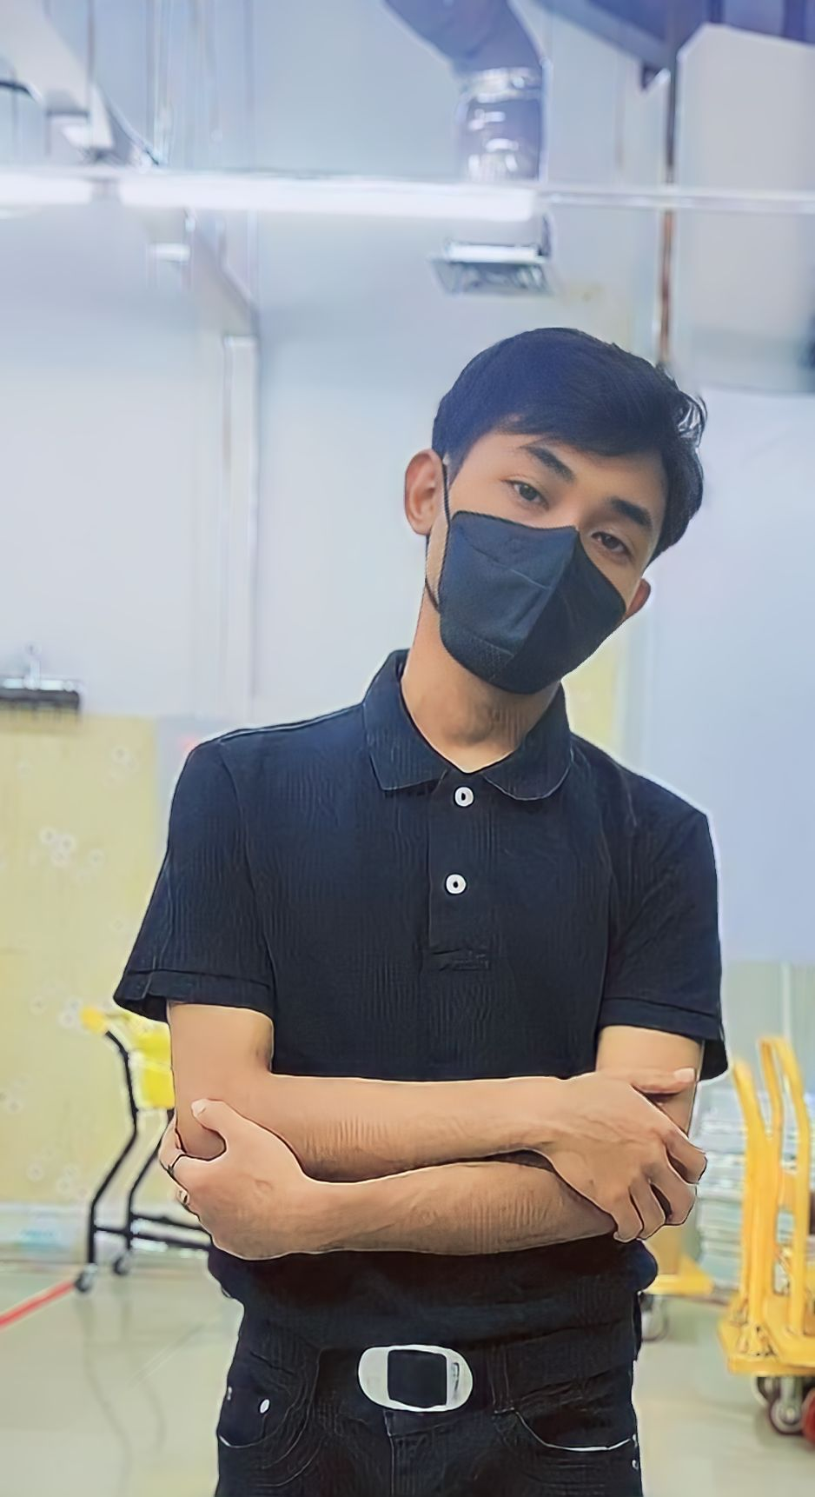
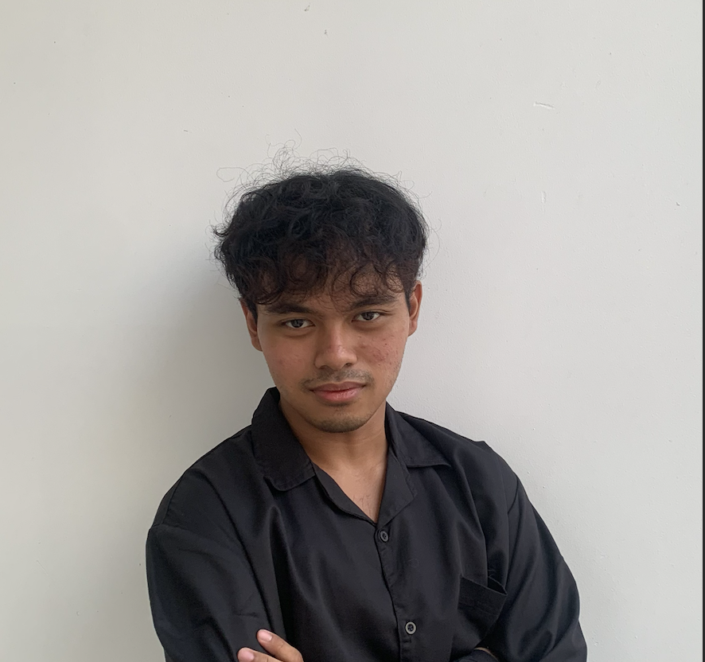
Meet The Team
Tri Wahyu Prabowo
Yurixa Sakhinatul Putri
Hendra Ronaldi
Nadya Novalina
Satriaji Najha Darmawan
Project Leader & Data Preparation
Model Development & Optimization
Model Development & Optimization
Model Development & Optimization
Model Development & Deployment
Tri Wahyu Prabowo
Yurixa Sakhinatul Putri
Hendra Ronaldi
Nadya Novalina
Satriaji Najha Darmawan
Fathurrahman Hernanda Khansan
I Putu Ananta Yogiswara
Harrison
Fitrah Ramadhan Reza
Hilmy Rahmadani
Model Development & Optimization
Model Development & Optimization
Model Development & Optimization
Model Development & Optimization
Model Development & Optimization
Fathurrahman Hernanda Khansan
I Putu Ananta Yogiswara
Harrison Han
Fitrah Ramadhan
Hilmy Rahmadani

Slide 3

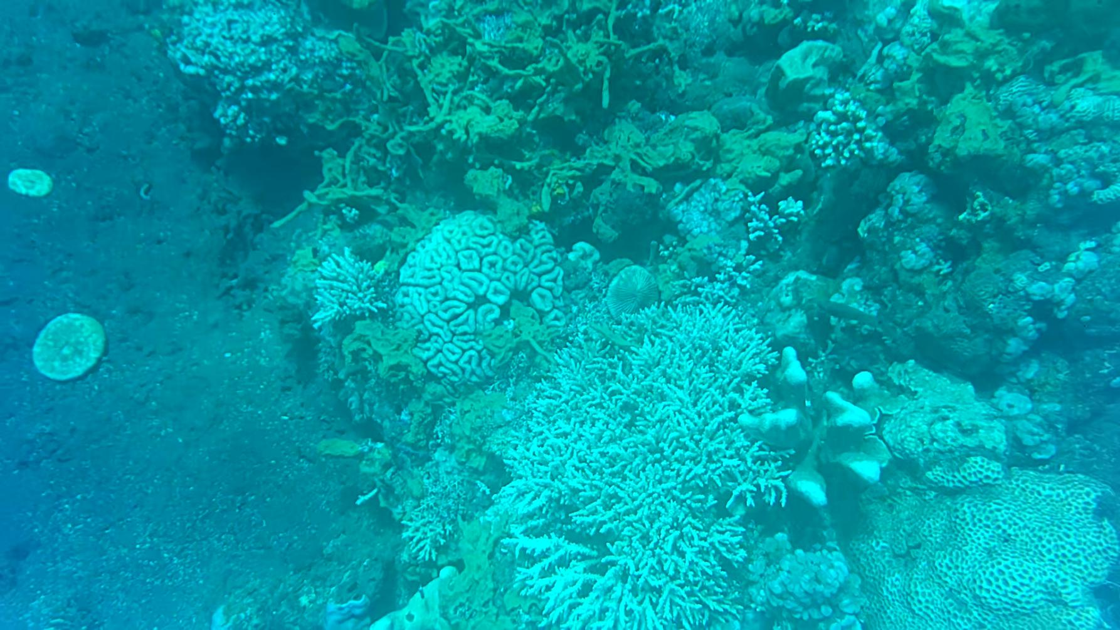
Background & Problem Statement
Coral reefs, often referred to as the "rainforests of the sea," are some of the most diverse ecosystems in the world. Thousands of species rely on reefs for survival. Millions of people all over the world also depend on coral reefs for food, protection and jobs. Unfortunately, these vital ecosystems are facing unprecedented threats due to climate change.
National Oceanic and Atmospheric Administration (NOAA) stated that climate change will affect coral reef ecosystems, through sea level rise, changes to the frequency and intensity of tropical storms, and altered ocean circulation patterns. When combined, all of these impacts dramatically alter ecosystem function, as well as the goods and services coral reef ecosystems provide to people around the globe.
Traditional methods of coral assessment, such as Line Intercept Transect (LIT) for identifying coral coverage, often face limitations in terms of scope and efficiency. These limitations are particularly evident in survey scalability and the constraints of human diving time. To bridge this gap, our project is dedicated to the utilization of automatic Coral Life Forms Detection for conducting a comprehensive analysis of coral coverage during site surveys by an underwater robot.
By integrating cutting-edge detection techniques into an automated coral monitoring method using an underwater robot, our objective is to offer a more nuanced understanding of how climate change impacts various coral species, their distribution, and overall reef dynamics. This endeavor aims to empower researchers and conservationists to make decisions about further interventions more efficiently.

Slide 4
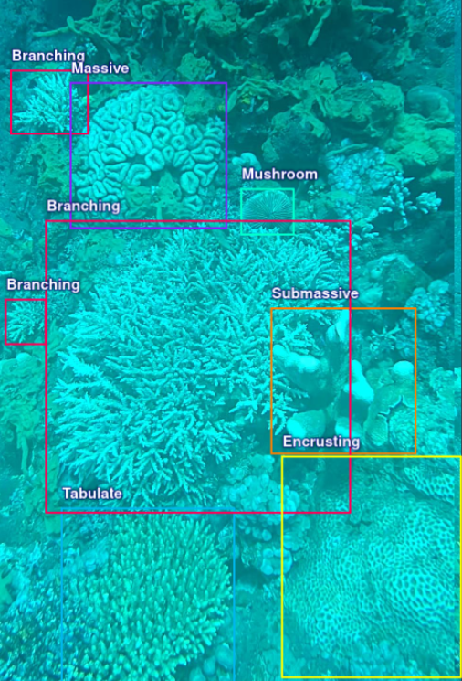
Objectives & Scope
Objectives
Develop deep learning models for identifying and analyzing coral life forms, focusing on seven main forms (Branching, Massive, Submassive, Foliose, Mushroom, Tabulate, Encrusting).
Scope
Explore YOLO state of the art object detection algorithm in developing deep learning model for coral life forms detection.

Slide 5
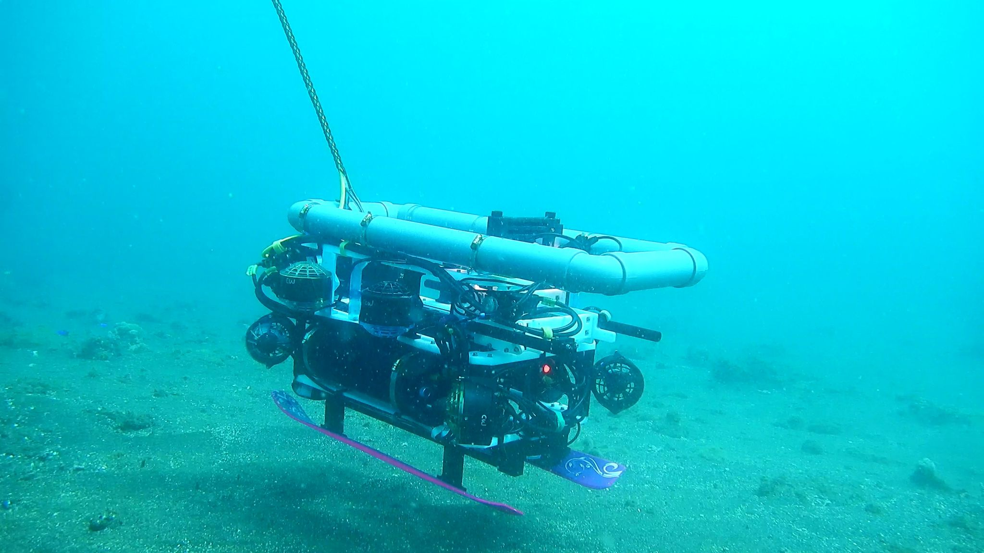
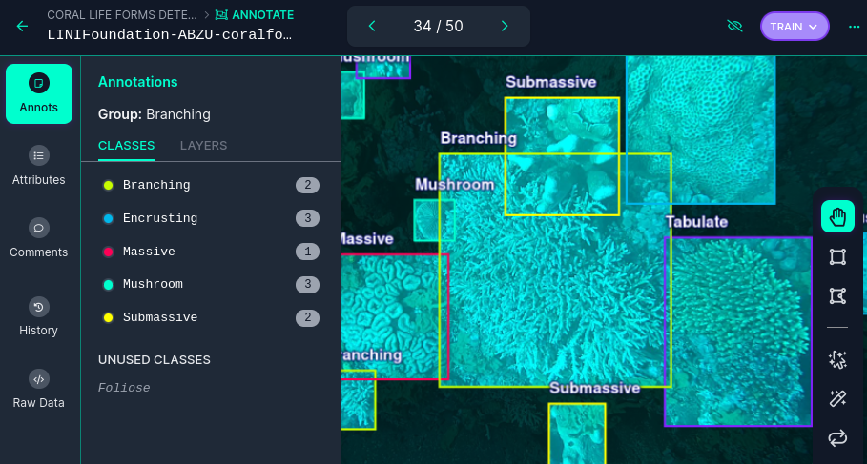
Data Collection
ROV / Underwater Robot
Manual Annotation
The data is collected through video extraction recorded by a Remotely Operated Underwater Vehicle (ROV) conducting surveys of coral reefs at depths ranging from 8 to 15 meters underwater in the North Bali Sea.
The extracted images then proceed to undergo manual annotation into seven distinct classes within Roboflow, enabling a detailed classification of coral life forms.

Slide 6
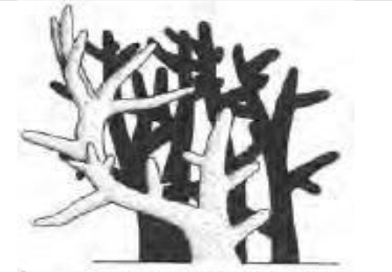
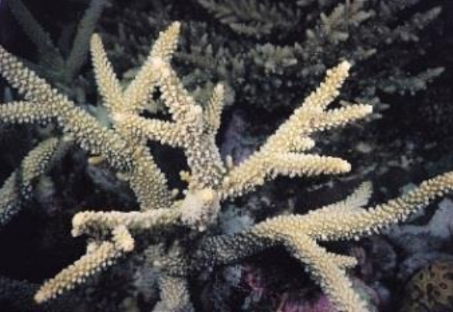
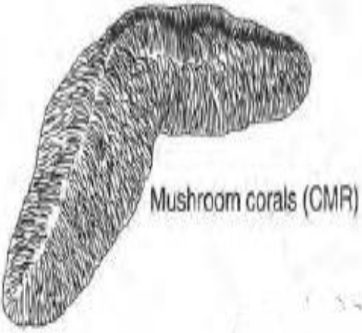
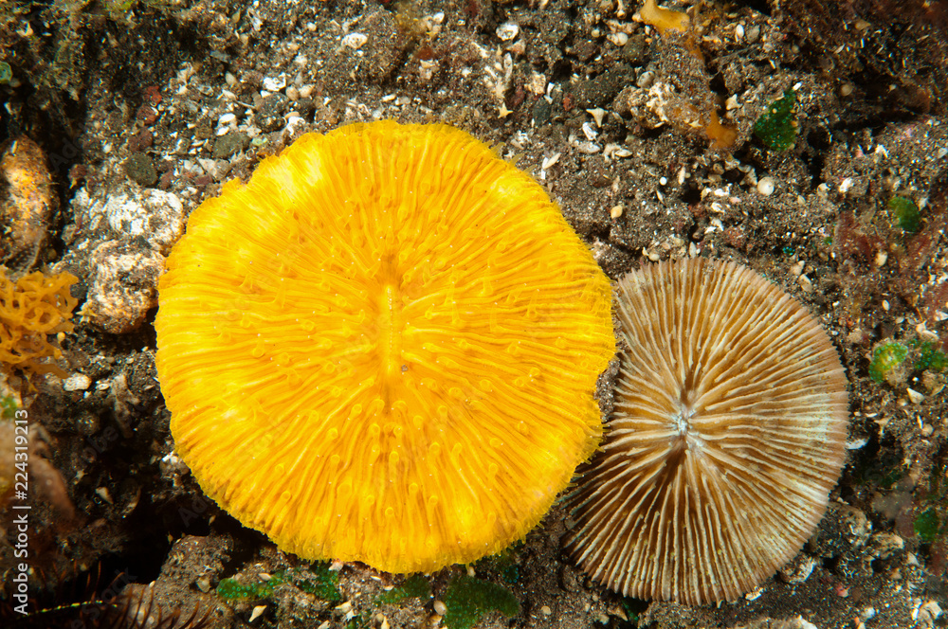
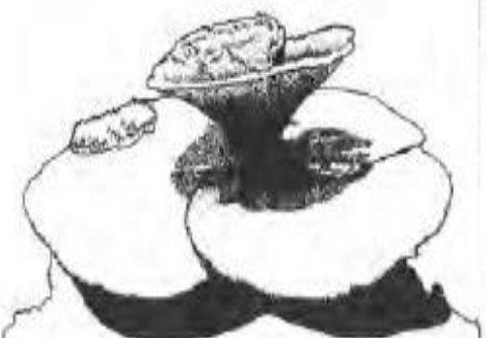
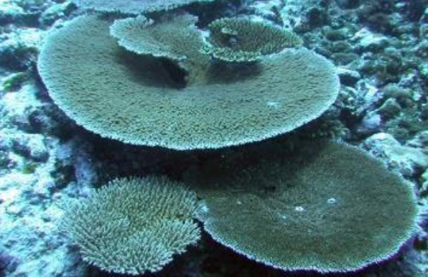
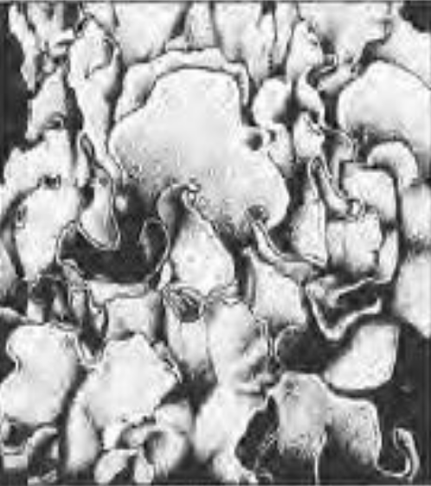
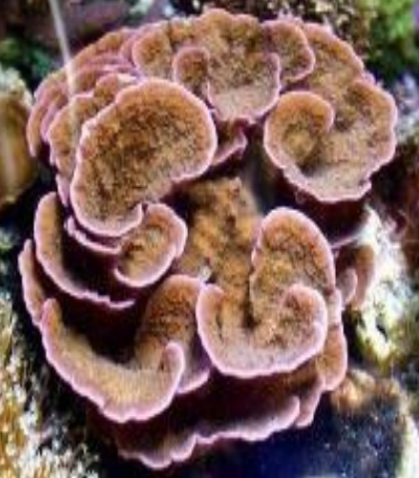
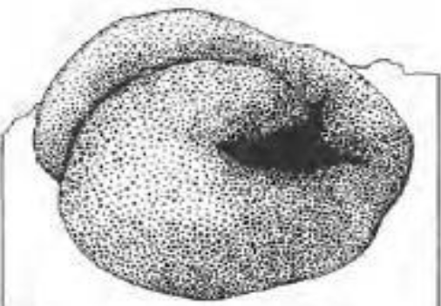
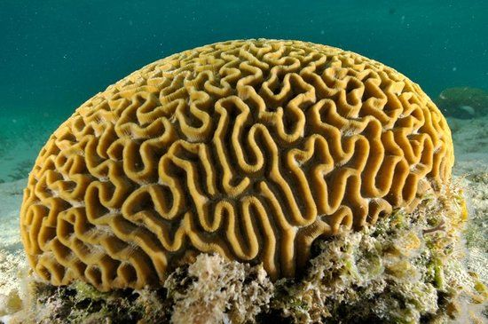
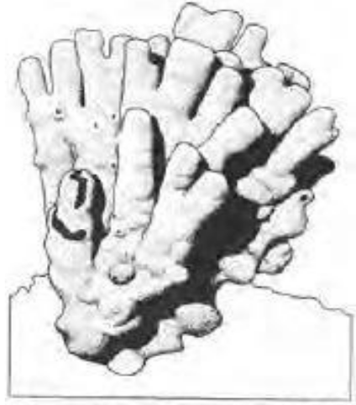
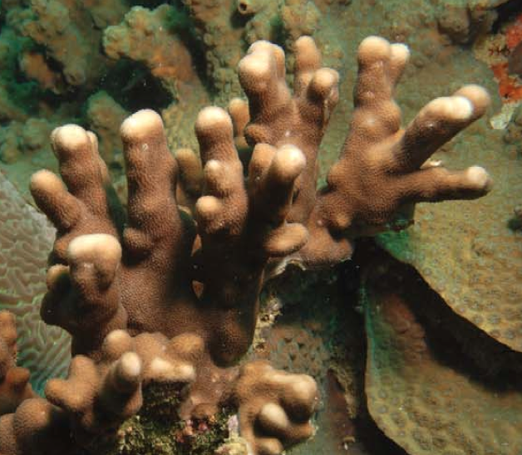
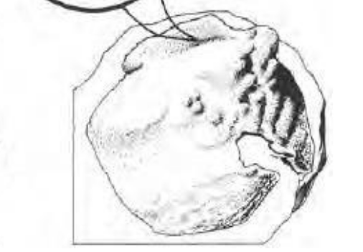
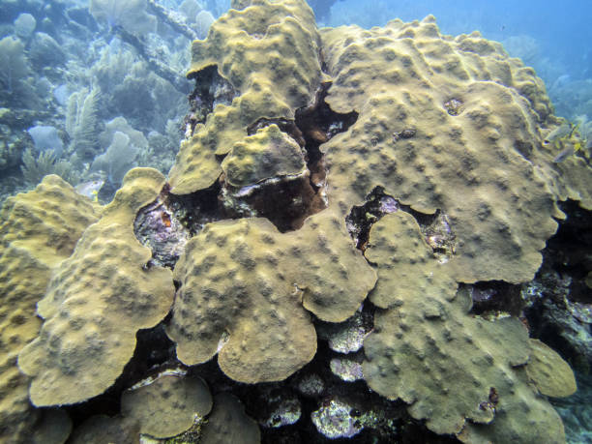
Data Understanding
Coral Branching
Coral Mushroom
Coral structure resembles tree-like branches.
Mushroom-like appearance with a flattened, circular or oval shape and a central mouth.
Coral Tabulate
Corals form flat, tabletop-like structures.
Coral Foliose
Colonies form flattened, leaf-like structures, develop thin and plate-like formations that often create intricate and delicate appearances.
Coral Massive
Solid appearance with a rounded or boulder-like shape.
Coral Submassive
Coral Encrusting
Combination of massive and branching structures. Rounded or columnar structures with irregular branching components.
Coral species where the colonies grow as thin layers, closely adhering to the substrate.

Slide 7
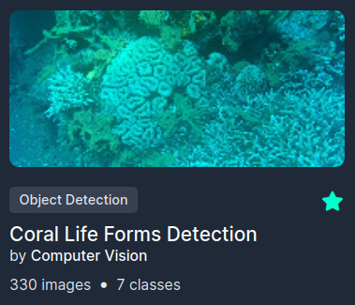

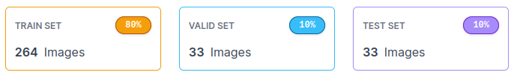
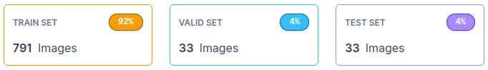
Data Preparation
Original
Preprocessing Auto-Orient Resize (640x640)
Augmentation Flip (Horizontal, Vertical) Grayscale (15%) Hue (+/- 15°)
Augmented

Slide 8



Model Development
Implementing YOLO (You Only Look Once) as a state-of-the-art real-time object detection system that stands out for its real-time capabilities, achieving high accuracy and speed by simultaneously predicting bounding boxes and class probabilities with a single neural network.
Explore and examining the architectural variations of YOLOv3, YOLOv5, and YOLOv8 to optimize the accuracy and efficiency of the coral life form detection system.
YOLO variation using ultralytics library:
YOLOv3
YOLOv3u
YOLOv5s
YOLOv5l
YOLOv5m
YOLOv8n
YOLOv8s
YOLOv8m
YOLO v8l
YOLOv8x
Notes:
Kita menerapkan YOLO (You Only Look Once) sebagai state of the art sistem deteksi objek real-time mutakhir yang menonjolkan kemampuan real-time-nya, mencapai akurasi dan kecepatan tinggi dengan secara bersamaan memprediksi kotak pembatas dan probabilitas kelas dengan jaringan neural tunggal.
Kita melakukan eksploarasi variasi arsitektur YOLOv3, YOLOv5, dan YOLOv8 untuk mengoptimalkan akurasi dan efisiensi sistem deteksi bentuk kehidupan karang.

Slide 9
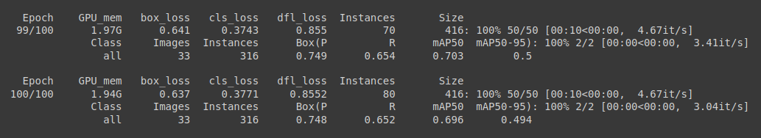
Training & Optimization
Hyperparameter
Epoch :100
Batch_size : 16
Img_size : 416
Learning Rate :
lr0 = 0.01
lrf = 0.0001
Momentum: 0.937
Weight Decay: 0.0005
Optimizer : AdamW
YOLO Augmentation (Default)
Mosaic : 1.0
Translate: 0.1
Scale: 0.5
fliplr: 0.5
hsv_h (hue): 0.015
hsv_s (saturation): 0.7
hsv_v (value): 0.4

Slide 10
To evaluate the performance of our YOLO model, We utilized evaluation metrics such as Precision, Recall, mAP50, and mAP(50-95).
Precision:
Definition: Precision measures the accuracy of positive predictions made by the model. It is the ratio of correctly predicted positive instances to the total instances predicted as positive.
Formula: Precision = True Positives / (True Positives + False Positives)
Interpretation: A high precision indicates that when the model predicts an object, it is likely to be correct.
Recall:
Definition: Recall, also known as sensitivity or true positive rate, assesses the model's ability to capture all relevant instances of a class. It is the ratio of correctly predicted positive instances to the total actual positive instances.
Formula: Recall = True Positives / (True Positives + False Negatives)
Interpretation: A high recall value indicates that the model can effectively identify most of the true positive instances.
mAP50 (mean Average Precision at 50):
Definition: mAP50 is the mean Average Precision calculated at an intersection over union (IoU) threshold of 50%. It represents the average precision across different confidence levels for predicted bounding boxes.
Interpretation: mAP50 gives an overview of the model's performance at a standard IoU threshold, which is commonly set at 50%.
mAP(50-95) (mean Average Precision between 50 and 95):
Definition: mAP(50-95) is the mean Average Precision calculated over a range of IoU thresholds, typically from 50% to 95%. It provides a more comprehensive evaluation of the model's accuracy at varying degrees of overlap between predicted and ground truth bounding boxes.
Interpretation: mAP(50-95) offers insights into the model's robustness across a spectrum of IoU thresholds, accounting for different levels of object overlap.

Slide 11
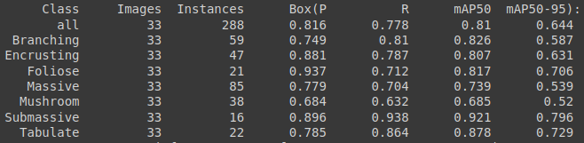
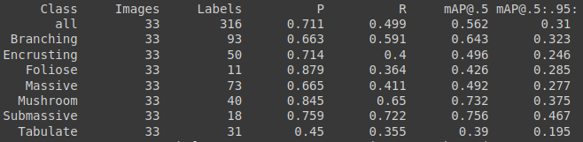
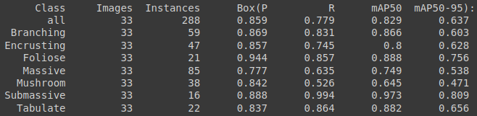
Results
YOLOv3u
Validation Results from representatives of each version from YOLOv3, YOLOv5, and YOLOv8
YOLOv5s
YOLOv8s

Slide 12
Overall Results Comparison
Model | epoch | Input size | Batch size | GPU | Precision | Recall | mAP50 | mAP(50-95) | Inference time (ms)
YOLOv3 | 100 | 416 | 16 | T4 | 0.784 | 0.664 | 0.715 | 0.55 | ±18
YOLOv3u | 100 | 416 | 16 | T4 | 0.816 | 0.778 | 0.810 | 0.644 | ±21
YOLOv5s | 100 | 416 | 16 | T4 | 0.755 | 0.510 | 0.562 | 0.310 | ±11
YOLOv5m | 100 | 416 | 16 | T4 | 0.707 | 0.500 | 0.562 | 0.308 | ±10
YOLOv5l | 100 | 416 | 16 | T4 | 0.742 | 0.706 | 0.687 | 0.582 | ±10
YOLOv8n | 100 | 416 | 16 | T4 | 0.840 | 0.625 | 0.750 | 0.538 | ±11
YOLOv8s | 100 | 416 | 16 | T4 | 0.859 | 0.779 | 0.829 | 0.637 | ±11
YOLOv8m | 100 | 416 | 16 | T4 | 0.877 | 0.748 | 0.820 | 0.631 | ±15
YOLOv8l | 100 | 416 | 16 | T4 | 0.843 | 0.768 | 0.828 | 0.660 | ±18
YOLOv8x | 100 | 416 | 16 | T4 | 0.801 | 0.695 | 0.782 | 0.535 | ±59

Slide 13
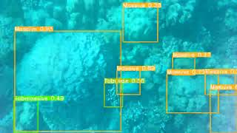
Video Inference Result (YOLOv8s)

Slide 14
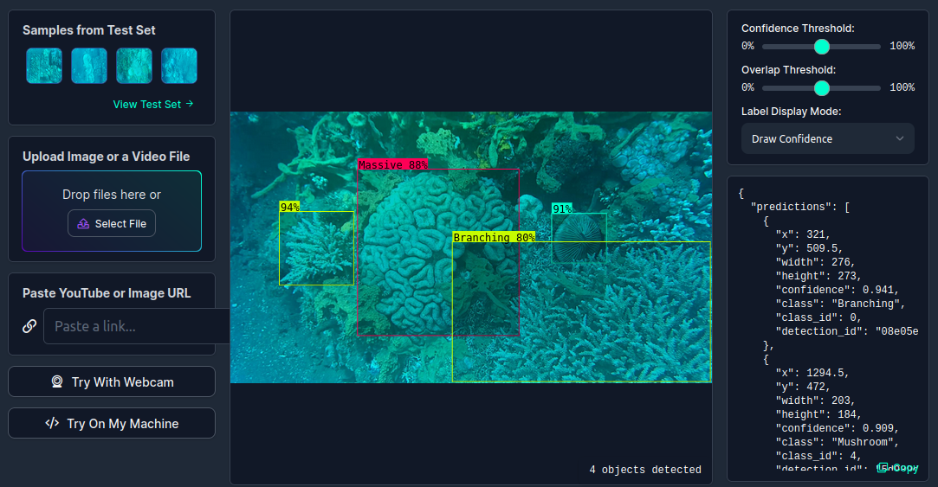
Real-world Application
Roboflow Web Deployment

Slide 15
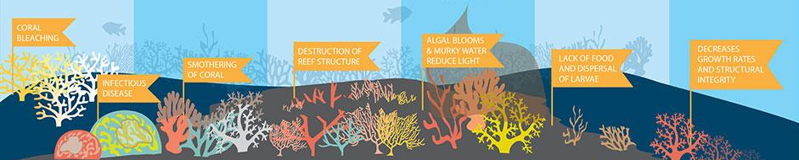
Conclusion
Upon comparing the training results among YOLOv3, YOLOv5, and YOLOv8, it becomes evident, based on precision, recall, and mAP evaluation metrics, that YOLOv8 achieves the highest overall evaluation score when compared to the other YOLO variants.
Considering the real-time deployment needs that necessitate fast inference times, we conclude that the YOLOv8s variation is the most optimal model for real-time deployment purposes. Where the overall score results on the evaluation metrics are among the highest. (Precision: 0.859; Recall: 0.779; mAP50: 0.829; mAP (50-95): 0.637), and the inference time is one of the fastest, with a value of 11 milliseconds (ms).

Slide 16
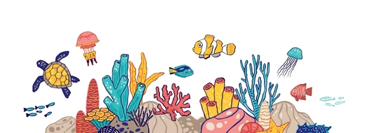
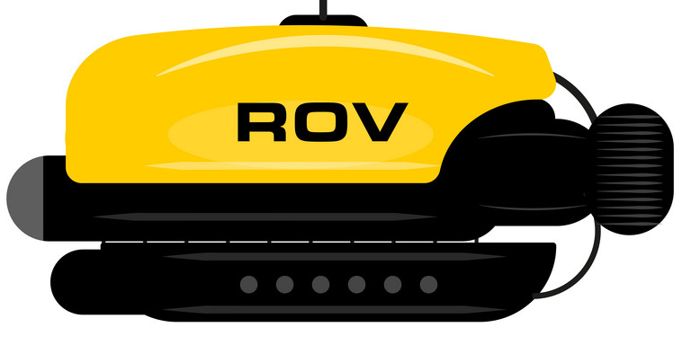
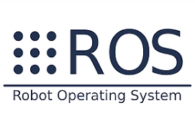
Future Improvement
Implement additional tracking and counting algorithms This addition will enable the model not only to identify and classify coral life forms but also to quantify population sizes, offering deeper insights into ecosystem dynamics.
Integrating into Robot Operating System (ROS) Integrate the coral detection system into the Robot Operating System (ROS) to facilitate real-time deployment using the underwater robot (ROV) in an actual coral reef ecosystem environment.
Carry out regular deployment in real time This advancement aims to transition the model into continuous monitoring, providing instant insights for practical conservation applications.

Slide 17

Contact Us
Don’t hesitate to contact us for further inquiries or any collaborations.
Tri Wahyu Prabowo
Hendra Ronaldi
Satriaji Najha Darmawan
Tri Wahyu Prabowo
Hendra Ronaldi
Satriaji Najha Darmawan
Yurixa Sakhinatul Putri
Harrison
Nadya Novalina
Yurixa Sakhinatul Putri
Harrison Han
Nadya Novalina
Fathurrahman Hernanda Khansan
I Putu Ananta Yogiswara
Fitrah Ramadhan Reza
Fathurrahman Hernanda Khansan
I Putu Ananta Yogiswara
Fitrah Ramadhan
Hilmy Rahmadani
Hilmy Rahmadani

